Slide 1
SONNET GENERATION USING AI
Team Size: 2
Member 1: Ann Rose Cherian
Member 2: Fathima Nada
Photo: https://drive.google.com/drive/folders/1njdTks8oKZoTRFStl74Rj1SLxGPeboIq?usp=sharing
https://drive.google.com/drive/folders/16ci9ufFHm-usIlAqzzdD3gNPKPW1ytIi?usp=sharing

Slide 2
ROLE OF TEAM MEMBERS
Ann Rose: Solution formation, Data analysis, Model training and testing, UI implementation of the model.
Fathima: Problem analysis and solution formation, Model training methodology, UI design and implementation.

Slide 3










TECHNOLOGIES AND PLATFORMS
Tensorflow
Keras
Numpy
Flask
Jupyter Notebook
Vscode
GitHub

Slide 4
SOLUTION ARCHITECTURE
Data preprocessing
Learning the data
Optimising data: The data had to be vectorized so that each unique character would be represented by an integer index for ease of prediction.
Choosing Model: For the best results, a LSTM model was found as most suitable.
Training the model: the model was trained considering the probabilities of each character in the list of possible characters and reweighting the probabilities.

Slide 5
The trained model is saved in-order for simpler prediction process.
Prediction: A random seed text from the training set is chosen and fed into the model. The next character is predicted based on the probability of each character and the temperature given.( Higher temp means random character, lower temp means more deterministic)
UI: The saved model is integrated with the UI using flask

Slide 6
DATA PROCESSING
As the first step, the data was organised into different sonnets
Details regarding data had to be learned and visualised:
No. Of sonnets
Character length of each sonnet
Character length of each line, etc.

Slide 7

MODEL TRAINING
Recurrent Neural Networks(RNN)

Slide 8
LSTM model is used to train the data.
A vector of sequences(each line) and targets is created which contains all the possible characters for the next character.
A set of unique character is taken from the data.
Long Short Term Memory

Slide 9
LSTM generates probabilities for each character
Based on the probability value for each character, the LSTM chooses the best match for the next character by considering the previous characters.
LSTM’s have 4 neural network layers making it the most suitable.
Each cell in the LSTM carries the relevant data needed for the prediction to the next stage.

Slide 10
GENERATION
As each character is predicted, the information passing through the LSTM changes.
Each time a character is predicted, we append it to the final string, thereby generating a full sonnet.

Slide 11
UI/UX DESIGN
Done with the help of HTML and micro-web-framework: Flask.
Output is rendered into HTML elements based on matching their id attribute to an output slot and by specifying the requisite css class for the element .
A new folder was created in the project directory called templates. Then a new file was added in the templates folder naming “index.html”.
Then by coding a few lines onto app.py after which the UI became ready for running.

Slide 12
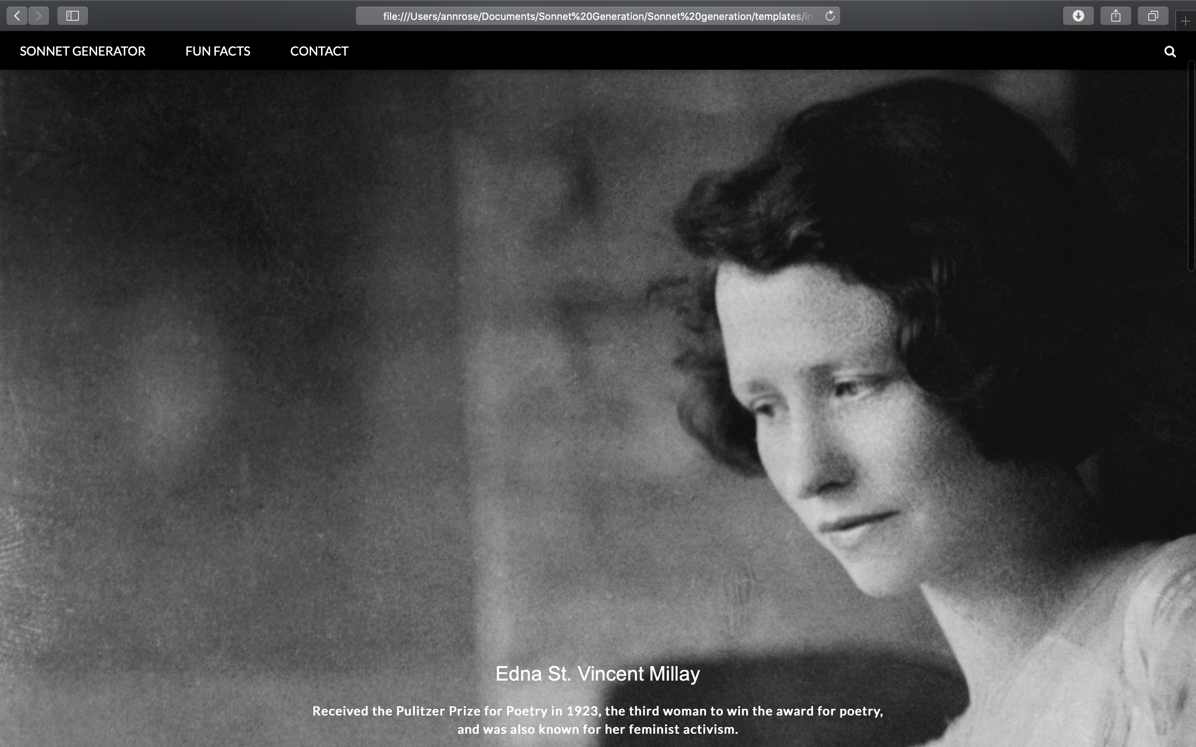

Slide 13
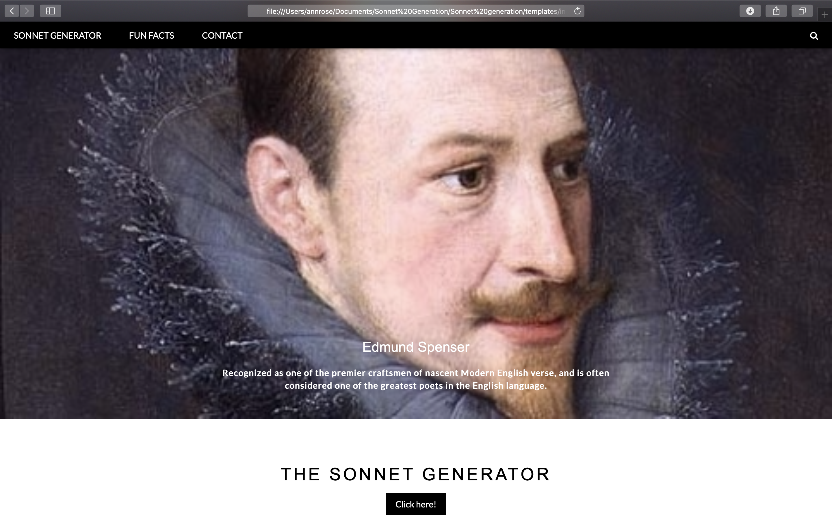

Slide 14
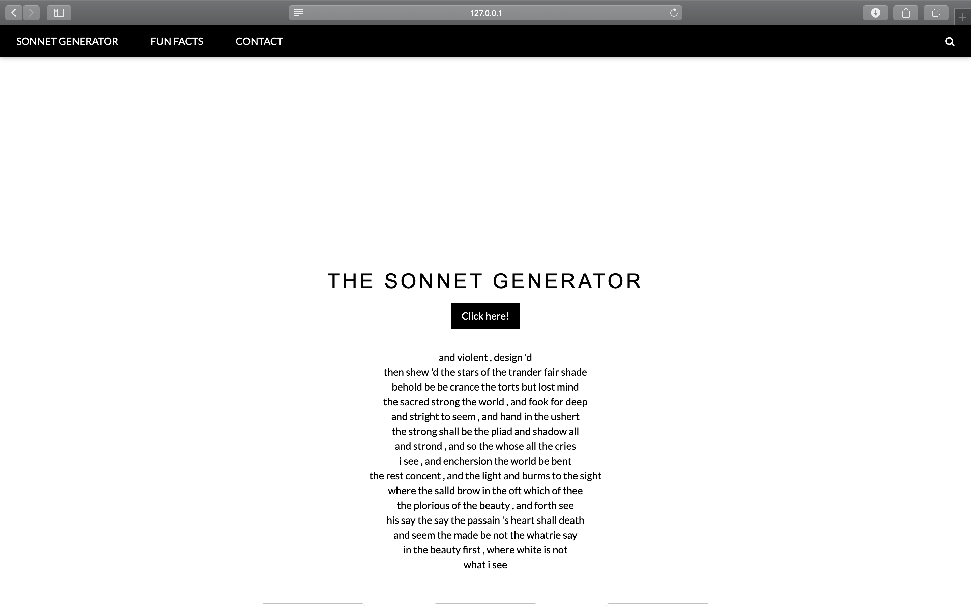

Slide 15
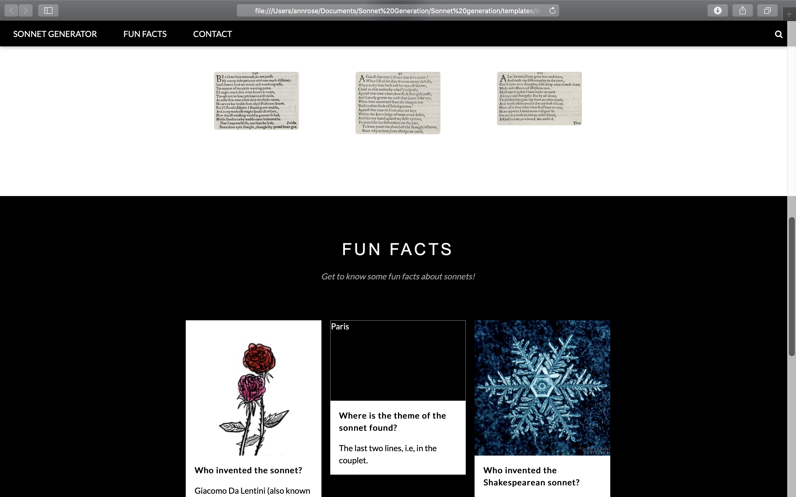

Slide 16
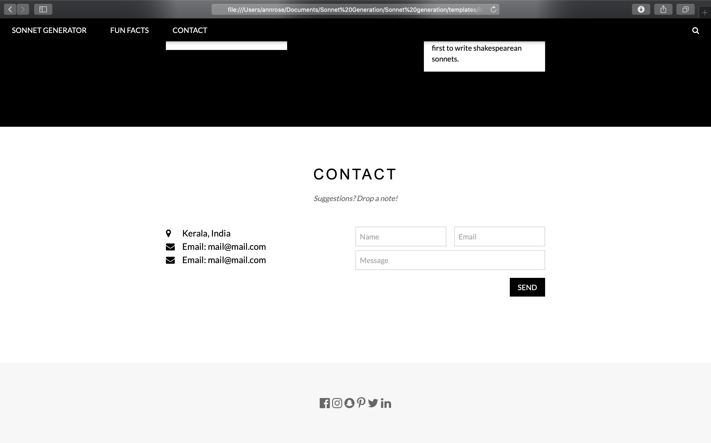

Slide 17
REFERENCES
https://livebook.manning.com/book/deep-learning-with-python/chapter-8/1
https://www.youtube.com/watch?v=UbCWoMf80PY&t=470s
https://www.analyticsvidhya.com/blog/2018/03/text-generation-using-python-nlp/

Slide 18
THANK YOU

